Slide 1


QUANTUM HACKATHON
Last Friday Night
Finn H.
Matthias K.
Gabriele R.
Giovanni Z.

Slide 2
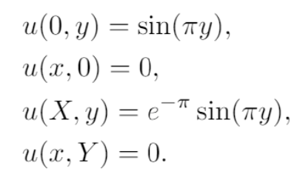
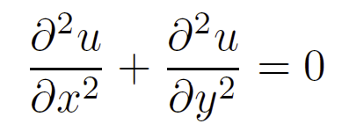
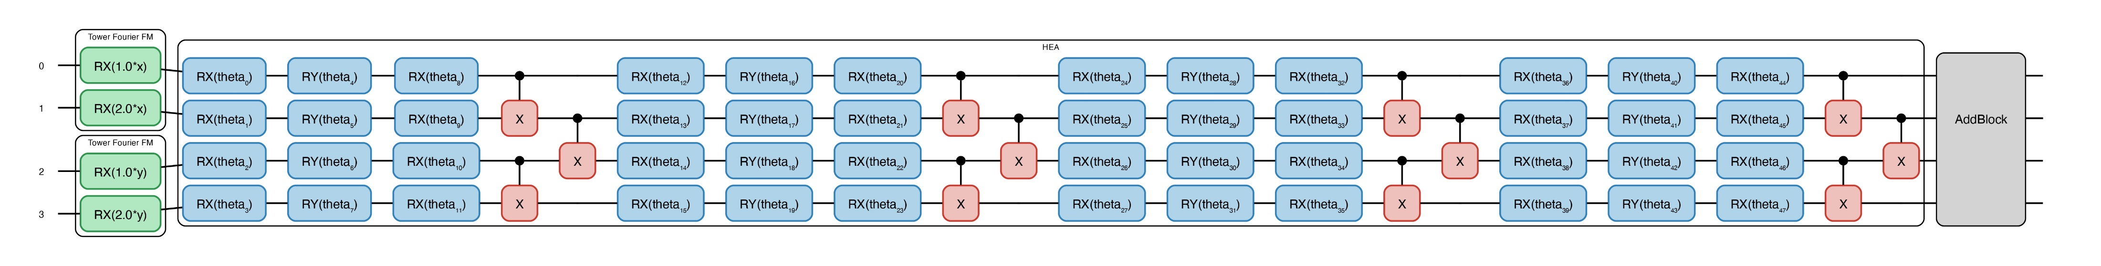
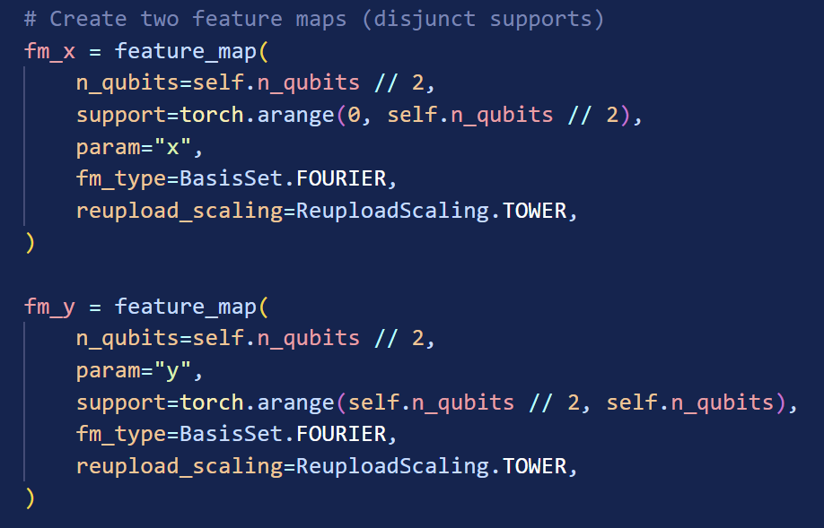
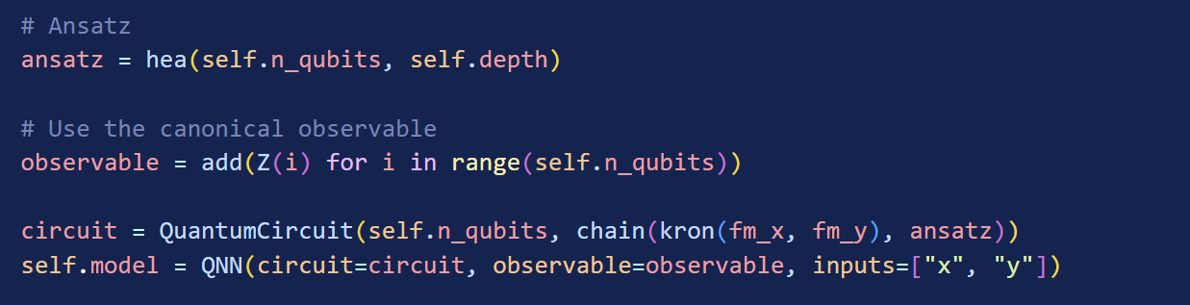
DQC: 2D Laplace function
QNN
FM
ANSATZ
$$n_{qubits}=4,6,8 n_{epochs}=500 depth=3$$

Slide 3
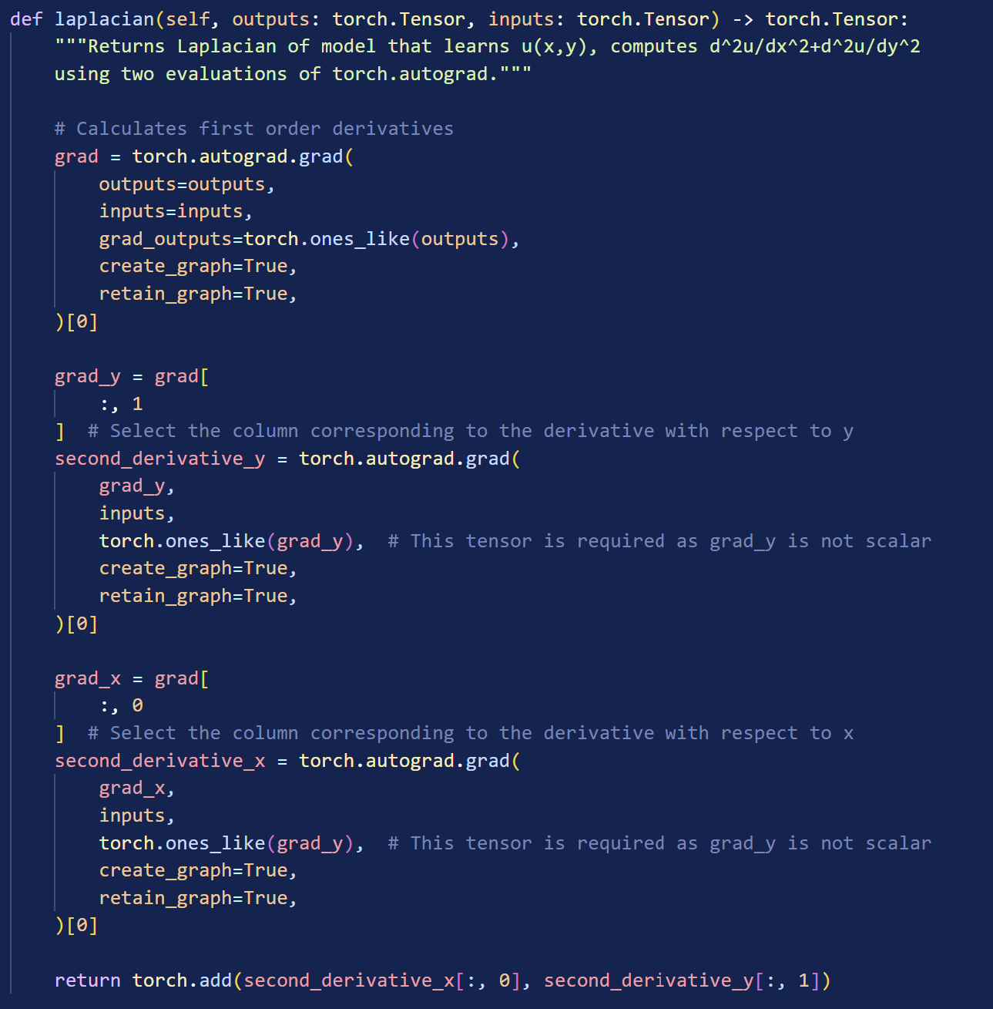
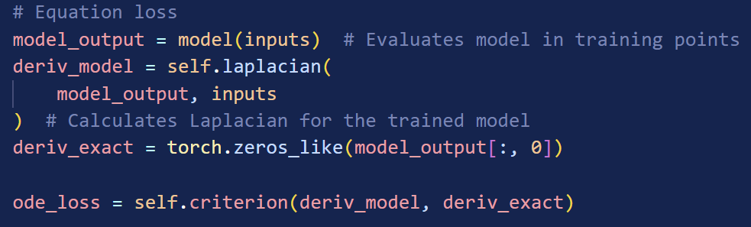
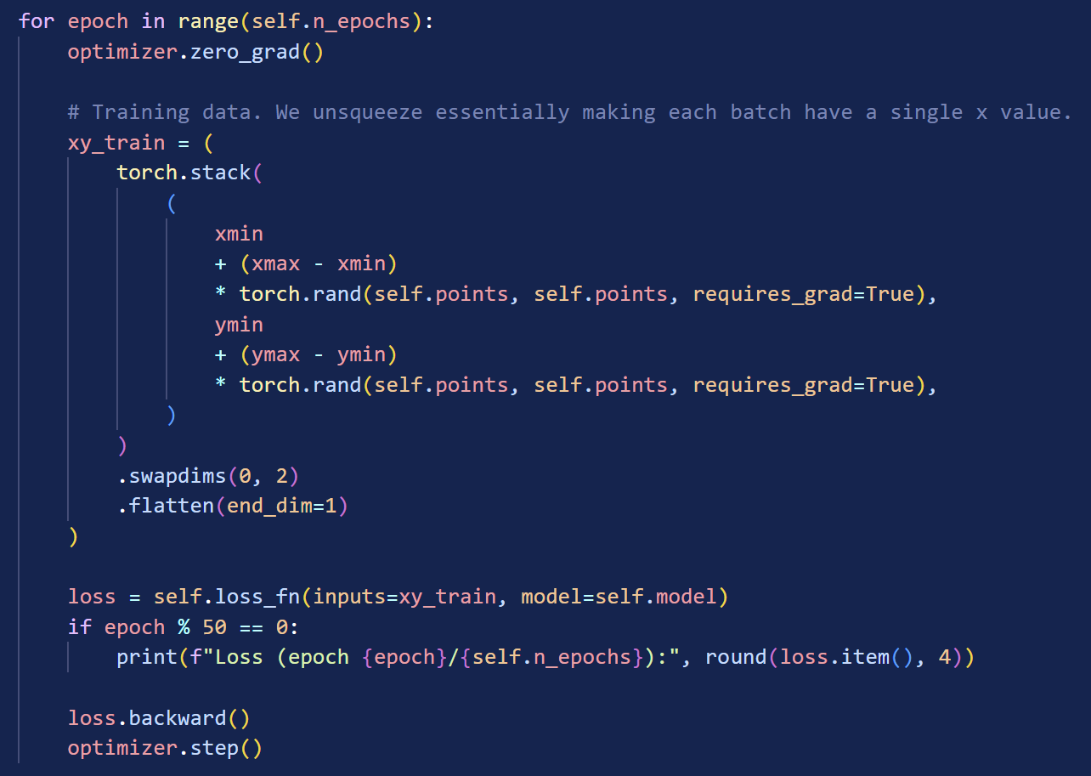
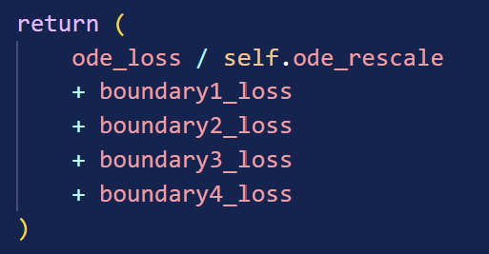



Task 1: Training model
$$+$$
$$+$$
Laplacian function ( $∇f)$
Loss Function
QNN (Model)
Training

Slide 4
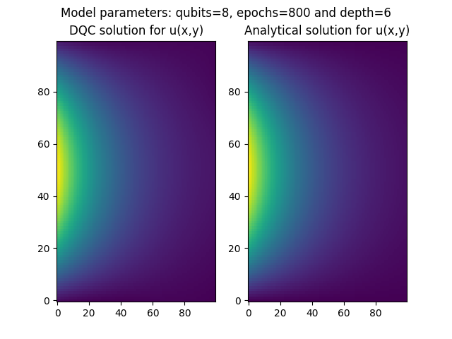
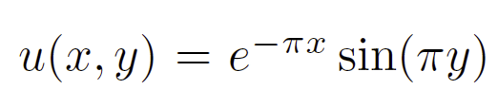
Task1: Results
Exact Solution:
y
Average MSE (10 runs):
1.23E-5
x

Slide 5
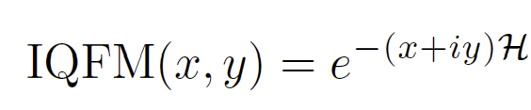
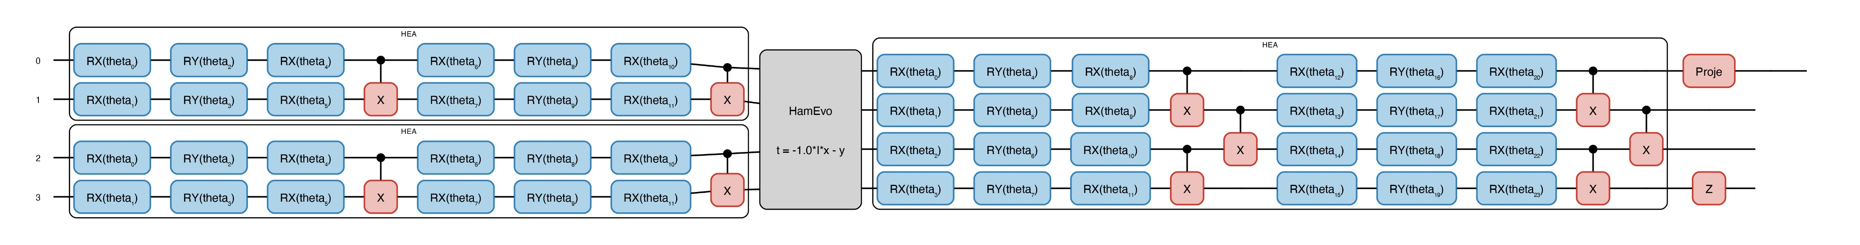
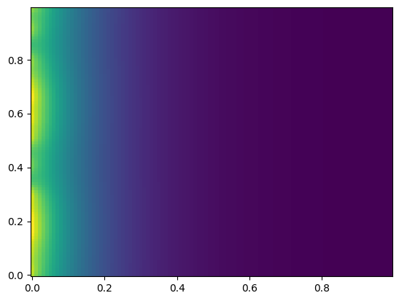
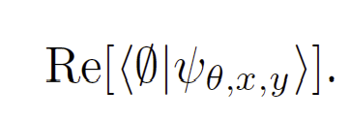
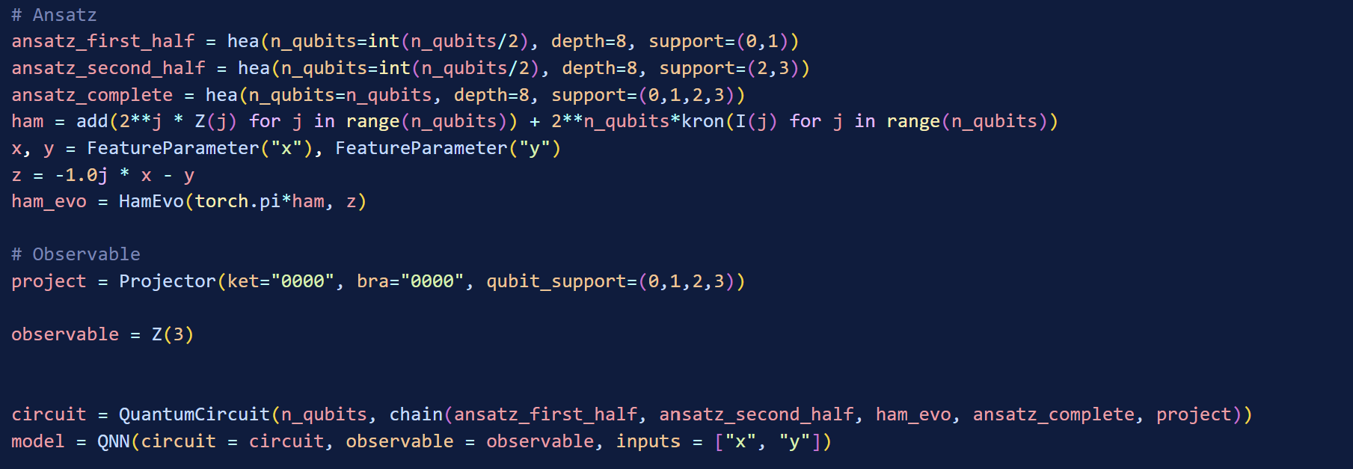
Bonus Task
P
Z
y
y
x

